Slide 1
Discrete Mathematics
South China University of Technology
1

Slide 2
Chapter 8. Graphs
Euler and Hamilton Paths
Section 8.5
2

Slide 3
Contents
1
Euler Paths and Circuit
2
Hamilton Paths and Circuit
3

Slide 4
Euler Paths and Circuit
4

Slide 5
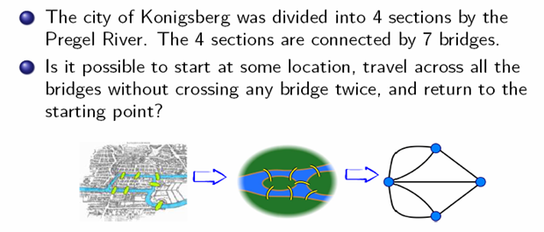
Konigsberg Seven Bridges Problem

Slide 6
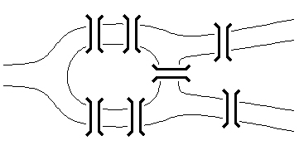
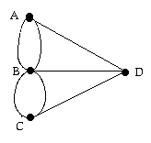
Konigsberg Seven Bridges Problem
The original problem
Equivalent multigraph
The Swiss mathematician Leonhard Euler solved this problem. His solution, published in 1736, may be the first use of graph theory.
Euler studied the problem by using a multiple graph.

Slide 7
Euler circuit
Definition 1:
An Euler circuit in a graph G is simple circuit containing every edge of G.
An Euler path in G is a simple path containing every edge of G.
No solution!!

Slide 8
Example 1
a
b
e
d
c
G1
The graph G1 has an Euler circuit, for example a, e, c, d, e, b, a.

Slide 9
Example 1
a
b
e
d
c
G2
G2 does not have an Euler circuit.
G2 does not have an Euler path, either.

Slide 10
Example 1
a
b
d
c
e
G3
G3 does not have an Euler circuit.
G3 has an Euler path: a, c, d, e, b, d, a, b.

Slide 11
Necessary Conditions
lemma: If a connected graph has an Euler circuit, then every vertex must have even degree.
Observation: Each time the circuit passes through a vertex a it contributes two to the vertex’s degree, since the circuit enters via an edge incident with this vertex and leaves via another such edge.

Slide 12
Necessary Conditions
Therefore, deg(a) must be even, because the circuit contributes two every time when it passes through a.
Therefore, if a connected graph has an Euler circuit, then every vertex must have even degree.
Necessary condition!!!

Slide 13
Sufficient Conditions
lemma: If all vertices have even degree in a connected multigraph, then an Euler circuit exists.
The proof is given with a construction.

Slide 14
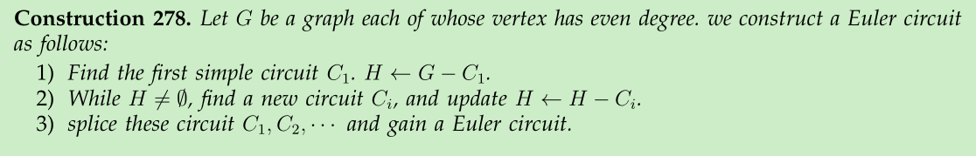
Basic idea of construction:
b
a
d
f
c
e

Slide 15
Example of construction
a
b
a
a
b
d
d
c
f
c
e
f
c
e
we can build simple circuit C1 =afcba , C2 =cdec
Finally, we splice them: afcdecba

Slide 16
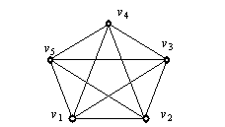
Example
C1 in G：v1 v2 v3 v4 v5 v1
C2 in G－C1 : v1 v3 v5 v2 v4 v1
v1 is the shared vertex of C1 and C2.
The Euler circuit is : v1 v2 v3 v4 v5 v1 v3 v5 v2 v4 v1

Slide 17
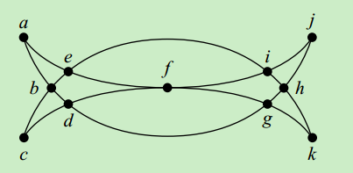
Example 3
Mohammed s scimitars
Every vertex has even degree.
Therefore, we can use algorithm 1 to solve its Euler circuit.

Slide 18
Example 3
1、a, b, d, c, b, e, i, f, e, a in G
2、d, g, h, j, i, h, k, g, f, d in H
3、 a, b, d, g, h, j, i, h, k, g, f, d, c, b, e, i, f, e, a

Slide 19
Theorem 1: A connected multigraph has an Euler circuit if and only if each of its vertices has even degree.
4 vertices of odd degree, it does not have an Euler circuit.

Slide 20
Theorem 2: A connected multigraph has an Euler path but not an Euler circuit if and if only if it has exactly two vertices of odd degree.
Main idea of the proof :
Every time the path goes through a there is path contributes one to the degree of a.
The terminal and the beginning vertices have odd degree.

Slide 21
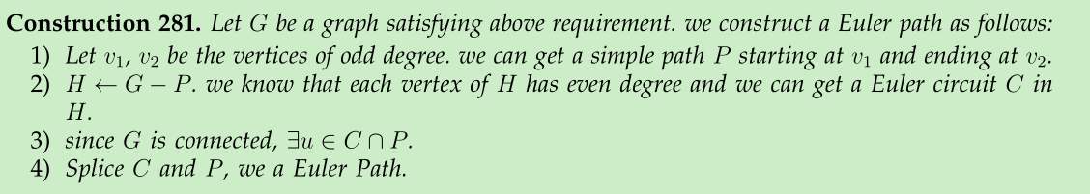

Slide 22
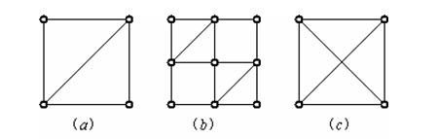
More examples
(a) an Euler path
(b) an Euler circuit
(c) no Euler circuit no Euler path

Slide 23
More examples
a
b
d
c
e
G3

Slide 24
a
b
e
d
c
G3
G3 has no Euler path since it six vertices of odd degree.

Slide 25
Application of Euler path
Chinese postman problem
If a postman can find an route that traverses each street exactly once ?
An edge represents a street.
Is there an Euler path in the graph? If no Euler path exists, some streets will have to be traversed more than once.

Slide 26
Hamilton Paths and Circuit
26

Slide 27
( Hamilton Paths
An Euler circuit in a graph G is a simple circuit containing every edge of G.
An Euler path in G is a simple path containing every edge of G.
A Hamilton circuit is a circuit that traverses each vertex in G exactly once.
A Hamilton path is a path that traverses each vertex in G exactly once. )

Slide 28
Hamilton Paths
Definition 2:
A path (x0, x1, …, xn-1, xn) in the graph G = <V, E> is called a Hamilton path if V = {x0, x1,…, xn-1, xn} and xi≠xj for 0≤i<j≤n.
A circuit (x0, x1, …, xn-1, xn, x0) is a Hamilton circuit, if (x0, x1, …, xn-1, xn) is Hamilton path.

Slide 29
Example 5
a
b
e
c
G1
d
G1 has a Hamilton circuit: a, b, c, d, e, a.

Slide 30
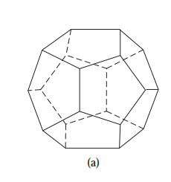
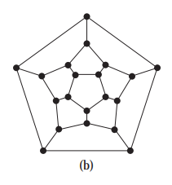
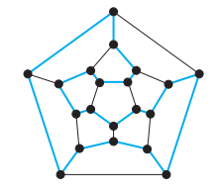
Source of the terminology
Hamilton path comes from a game, called Voyage Round the word puzzle, invented by Irish mathematician Sir William Rowan Hamilton.
The puzzle was to start at a city and travel along the edges of the dodecahedron十二面体, visiting each of the other 19 cities exactly once, and back for the first city.

Slide 31
Hamilton Paths
Definition: A Hamilton circuit is a circuit that traverses each vertex in G exactly once.
Let G a graph having a Hamilton circuit C. then(Necessary conditions:)
G has no vertexes of degree one.
C is a simple circuit. Further, C cannot contain a smaller circuit within it.

Slide 32
Example 5
a
b
d
c
G2
G2 does not have a Hamilton circuit.
G2 has a Hamilton path: a, b, c, d.

Slide 33
Example 5
b
g
a
d
c
e
f
G3
G3 does not have a Hamilton circuit.
G3 does not have a Hamilton path.

Slide 34
Example 6
a
d
e
b
c
G
There is no Hamilton circuit in G
since G has a vertex of degree one.

Slide 35
Example 6
a
b
c
d
e
H
All vertices have two degree.
But H has no Hamilton circuit, for any possible Hamilton circuit have to pass c twice.

Slide 36
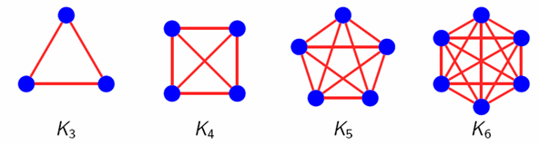
Example 7
We can form a Hamilton circuit in Kn beginning at any vertex.
Such a circuit can be built by visiting vertices in any order we choose, which is possible since there are edges in Kn between any two vertices.

Slide 37
Surprisingly, there are no known simple necessary and sufficient criteria for the existence of Hamilton circuits.
However, some sufficient criteria are know.

Slide 38
Sufficient conditions
Dirac’s theorem: Let G be a connected simple graph. If G has n≥3 vertices and ∀v deg(v)≥n/2, then G has a Hamilton circuit.
Ore’s theorem : Let G be a connected simple graph. If G has n≥3 vertices and deg(u)+deg(v)≥n for every pair u,v of non-adjacent nodes, then G has a Hamilton circuit.

Slide 39
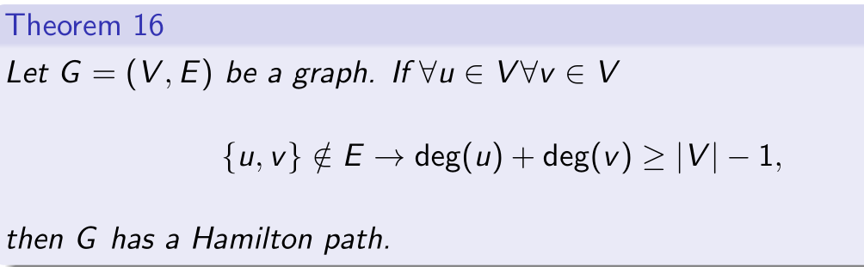
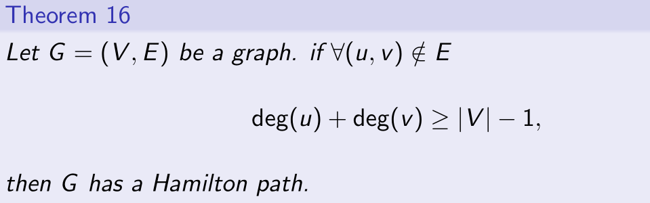
Hamilton path.

Slide 40
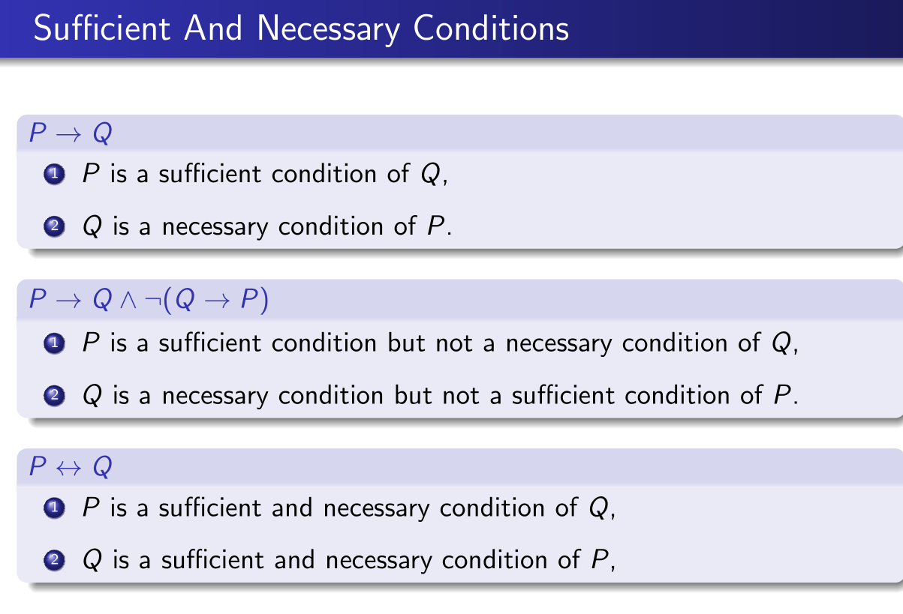

Slide 41
Fallacies
Fallacy 1. (( p → q ) ∧ q ) ⇒ p
Fallacy 2 : (( p → q ) ∧ ¬ p )⇒ ¬ q
Fallacy 1 is called the fallacy of affirming the conclusion.肯定结论谬论
Fact 1. (( p → q ) ∧ q ) !⇒ p
Fact 2 : (( p → q ) ∧ ¬ p )!⇒ ¬ q

Slide 42
Both Ore’s Theorem and Diac’s Theorem provide sufficient conditions for a connected simple graph to have a Hamilton circuit.
However, the theorems do not provide necessary conditions for the existence of a Hamilton circuit.

Slide 43
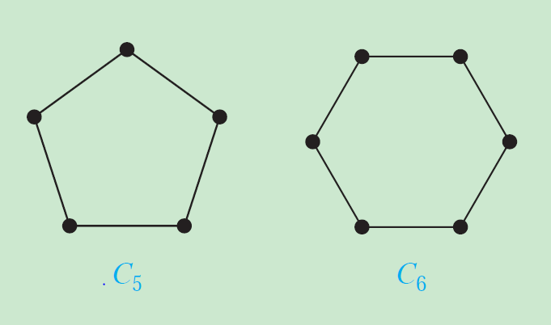
C5, C6 do not meet the requirements of previous theorem, however they have Hamilton circuits.

Slide 44
The best algorithm known for finding a Hamilton circuit in a graph or determining that no such circuit exist have exponential worst-case time complexity.
Finding an algorithm that solves this problem with polynomial worst-case time complexity would be a major accomplishment because it has been proved to be NP-complete.

Slide 45
Application
Hamilton circuits and paths can be used to solve practical problems.
Traveling salesman problem asks for the shortest route a traveling salesman should take to visit a set of cities.
The problem reduces to finding a Hamilton circuit in a complete graph such that the total weight of its edges is as small as possible.

Slide 46
Euler circuit VS Hamilton circuit
An Euler circuit in a graph G is a simple circuit containing every edge of G.
A Hamilton circuit is a circuit that traverses each vertex in G exactly once.
Common: they both are simple circuits in connected graphs.

Slide 47
Euler circuit VS Hamilton circuit
Difference:
1. Euler circuit and Euler path are mutual exclusive; Hamilton circuit and Hamilton path possibly coexists.
2. determining a Euler circuit is easy, while determining a Hamilton circuit is very hard, NPC.

Slide 48

应用题:
背景: 7天安排7门考试, 1天考1门, 要求是同一位教师所任的课程不能连续考.
求证: 如果每位老师担任的课程$≤$4, 那么那么上述问题有解.
关键点: 如何建模?

Slide 49
历史上的考题
A) B)
Which of the given graphs can be written in one stroke?
49

Slide 50
Homework
4
10
16, 19

Slide 51
End of Section 8.5
Click to edit company slogan .
51

